Slide 1
Finite Element Analysis of pipe
Samer Adeeb
May 2014
Effect of Properties and Geometry on Buckling Response

Slide 2
Background
Ph.D. Structural Engineering 2005. University of Calgary
TSTM, TCPL August 2004 – December 2006

Slide 3
Outline
Introduction – Loads on pipelines
Introduction – Finite Element Analysis
Internal Pressure and Bending in Cold Bends
Material Properties of HSS Pipes
Anisotropy models
Anisotropy and Buckling
Initial Imperfections of HSS Pipes
Measurement of Initial Imperfections
Initial Imperfections and Buckling

Slide 4
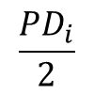
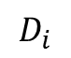
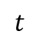
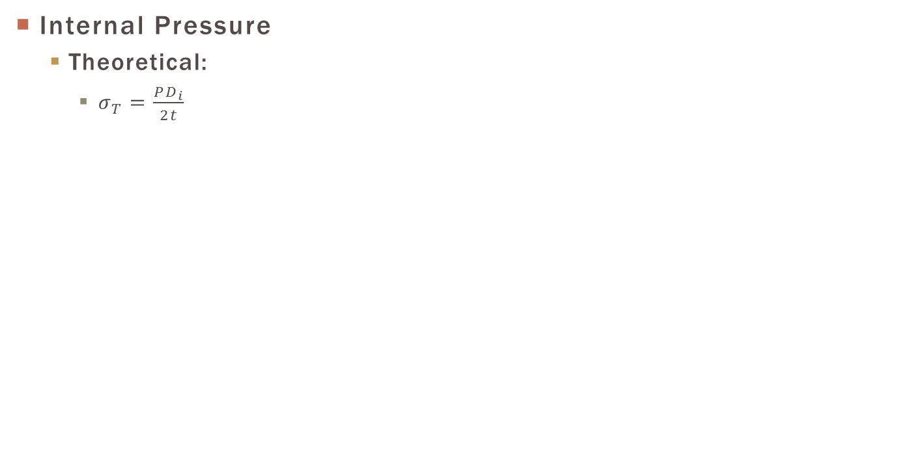
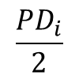
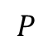
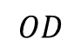
Intro: Loads on Pipe
Internal Pressure
Theoretical:
$σ_{T}=\frac{PD_{i}}{2t}$
$$t$$
$$P$$
$$\frac{PD_{i}}{2}$$
$$\frac{PD_{i}}{2}$$
$$D_{i}$$
$$OD$$

Slide 5
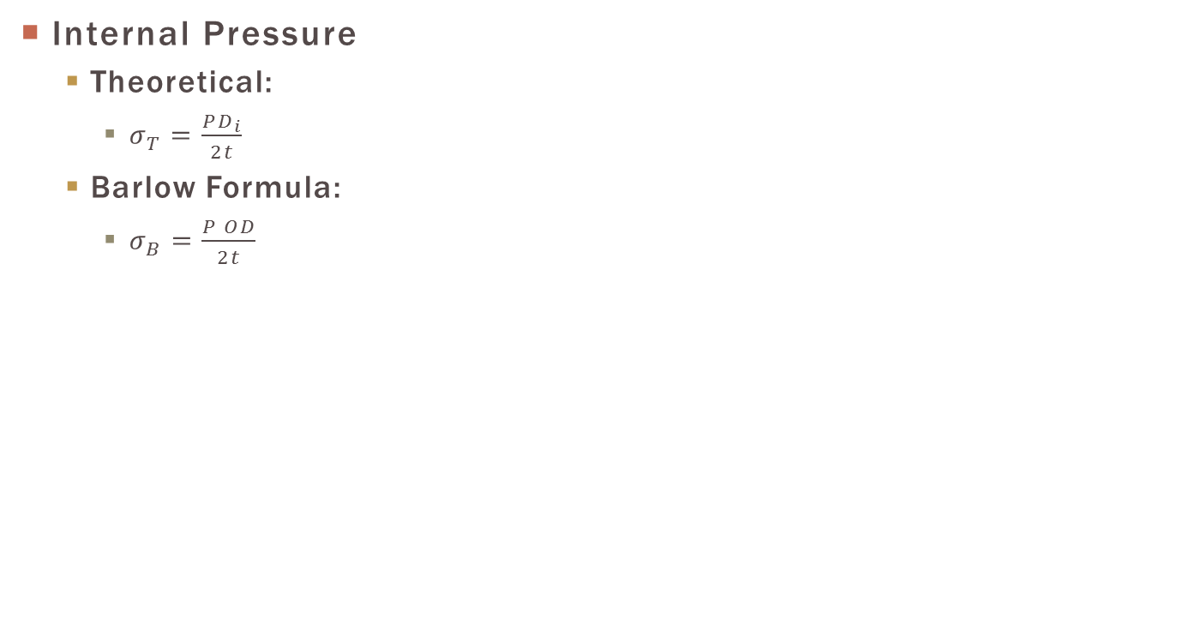
Intro: Loads on Pipe
Internal Pressure
Theoretical:
$σ_{T}=\frac{PD_{i}}{2t}$
Barlow Formula:
$σ_{B}=\frac{P OD}{2t}$
$$t$$
$$P$$
$$\frac{PD_{i}}{2}$$
$$\frac{PD_{i}}{2}$$
$$D_{i}$$
$$OD$$

Slide 6
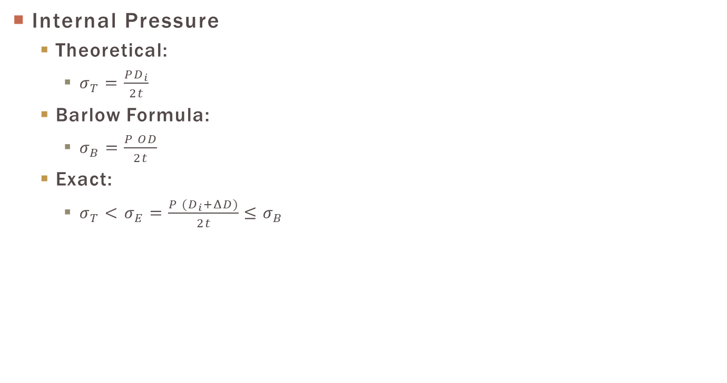
Intro: Loads on Pipe
Internal Pressure
Theoretical:
$σ_{T}=\frac{PD_{i}}{2t}$
Barlow Formula:
$σ_{B}=\frac{P OD}{2t}$
Exact:
$σ_{T}<σ_{E}=\frac{P (D_{i}+ΔD)}{2t}≤σ_{B}$
$$t$$
$$P$$
$$\frac{PD_{i}}{2}$$
$$\frac{PD_{i}}{2}$$
$$D_{i}$$
$$OD$$
Geometric Nonlinearity!

Slide 7
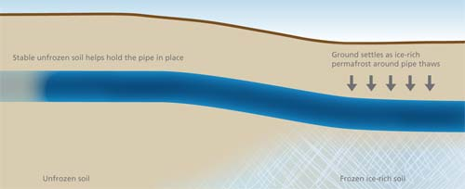
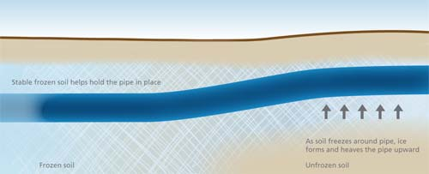
Intro: Loads on Pipe
Lateral Loads
http://www.neb-one.gc.ca/clf-nsi/rthnb/pplctnsbfrthnb/mcknzgsprjct/rfd/rfdv1p3-eng.html#p3s5

Slide 8
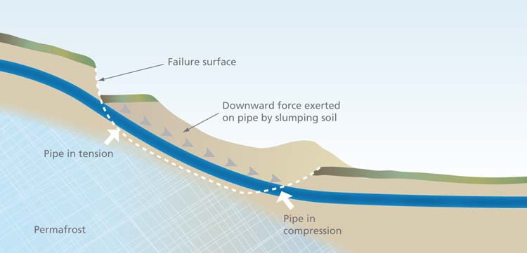
Intro: Loads on Pipe
Lateral Loads
http://www.neb-one.gc.ca/clf-nsi/rthnb/pplctnsbfrthnb/mcknzgsprjct/rfd/rfdv1p3-eng.html#p3s5

Slide 9
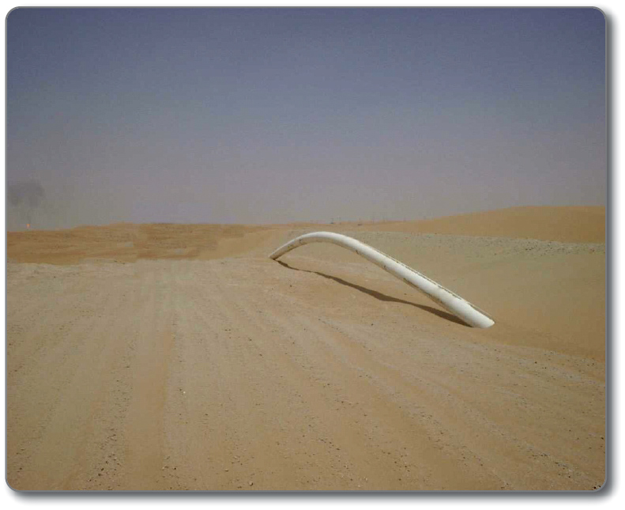
Intro: loads on pipe
Lateral Loads. Thermal Expansion and Upheaval Buckling
http://wiki.iploca.com/display/rtswiki/Appendix+6.2+-+Pipeline+Trench+Design

Slide 10
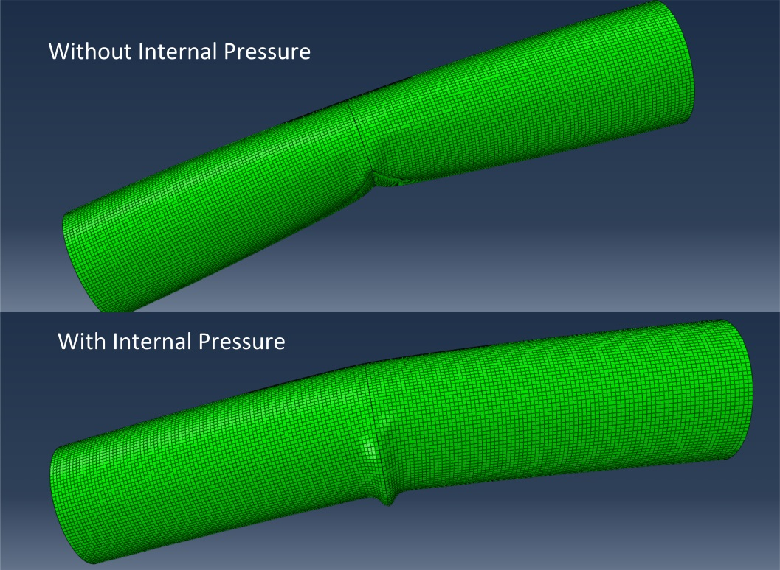
Intro: Loads on Pipe
Lateral Loads & Internal Pressure

Slide 11
Intro: Loads on Pipe
Lateral Loads & Internal Pressure
Complex Interaction!

Slide 12
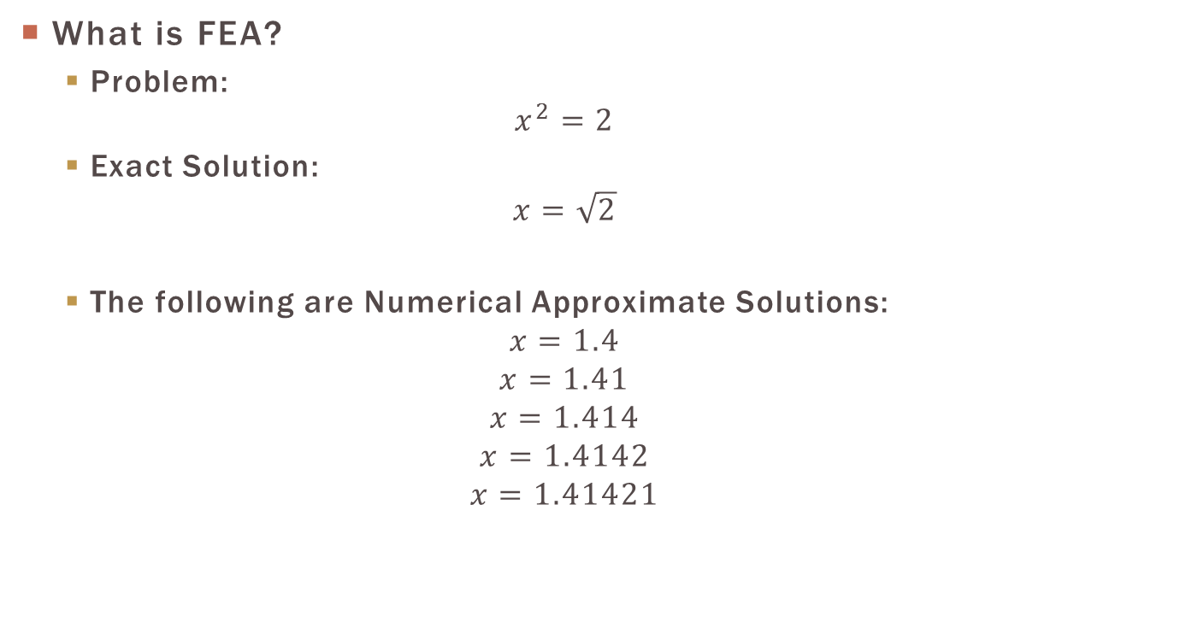
Intro: FEA
What is FEA?
Problem:
$$x^{2}=2$$
Exact Solution:
$$x=\sqrt{2}$$
The following are Numerical Approximate Solutions:
$$x=1.4$$
$$x=1.41$$
$$x=1.414$$
$$x=1.4142$$
$$x=1.41421$$

Slide 13
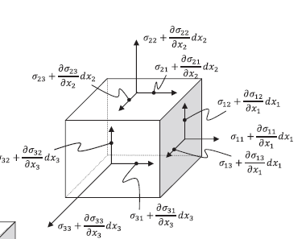
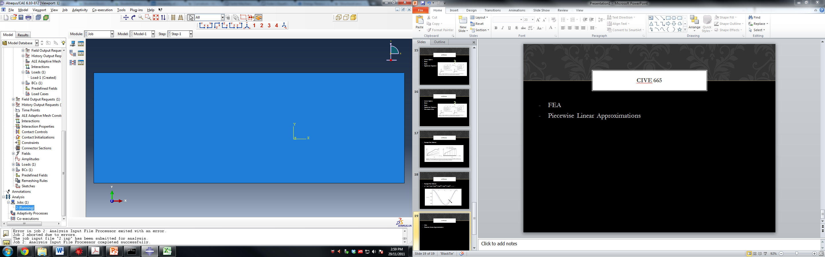
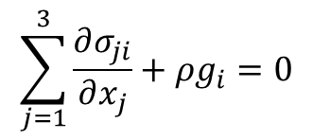
Intro: FEA
What is FEA?
$$\sum_{j=1}^{3}{\frac{∂σ_{ji}}{∂x_{j}}+ρg_{i}}=0$$

Slide 14
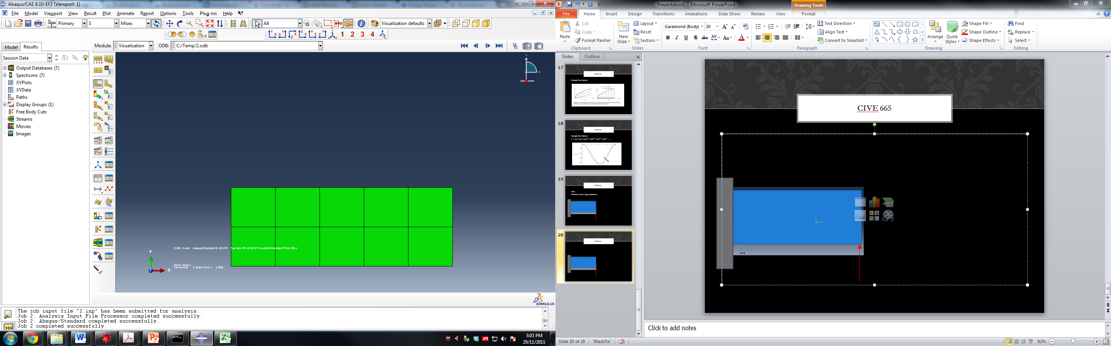
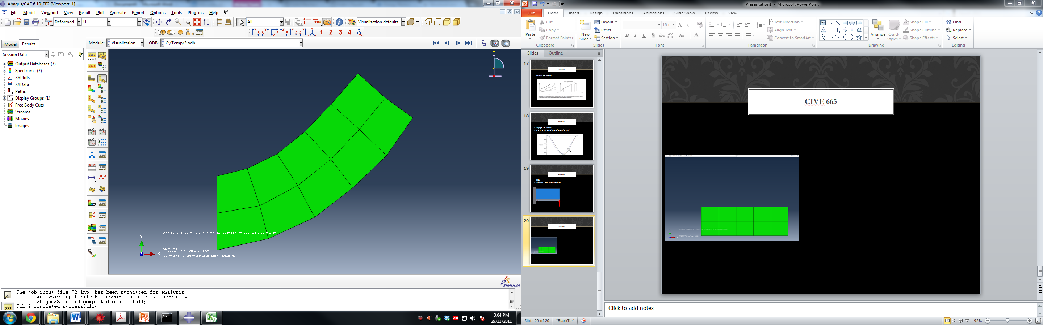
Intro: FEA
What is FEA?

Slide 15
Intro: FEA
What is FEA?

Slide 16
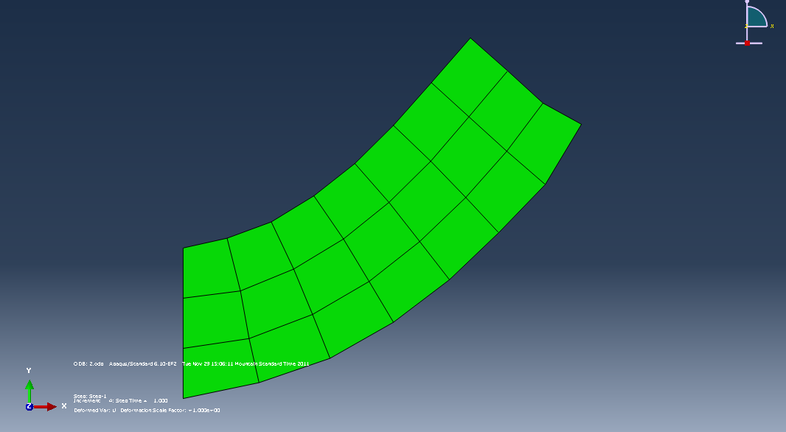
Intro: FEA
What is FEA?

Slide 17
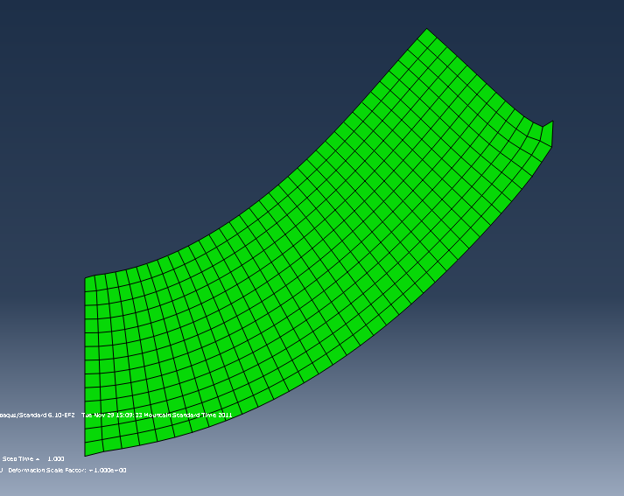
Intro: FEA
What is FEA?

Slide 18
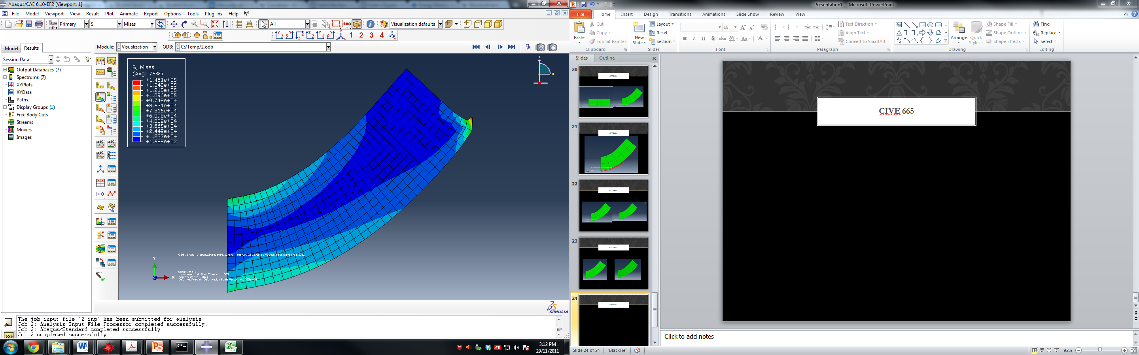
Intro: FEA
What is FEA?

Slide 19
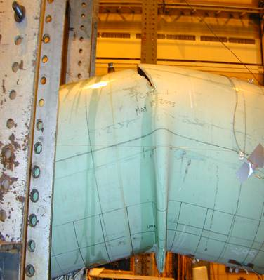
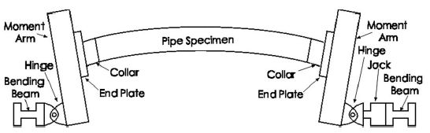
Internal Pressure and Bending in Cold Bends
Combined Load Experiments
[1] Sen, M. (2006); “Behaviour of Cold Bend Pipes Under Combined Loads” Ph.D. dissertation, University of Alberta, 2006
[2] Sen, M., Cheng, J.J.R., Zhou, J. (2011); “Behaviour of Cold Bend Pipes under Bending Loads”
DOI: 10.1061/(ASCE)ST.1943-541X.0000219. 2011 American Society of Civil Engineers

Slide 20
Internal Pressure and Bending in Cold Bends
Model
NPS30, t=8.29mm
Load
Cakiroglu, C.; Kainat, M.; Adeeb S.; Cheng, J.J.R. and Sen, M. (2014). Evaluation of Pressurized Cold Bend Pipe Body Tensile Fractures Under Bending Loads. Proceedings of the International Pipeline Conference (IPC 2014), September 29-October 3, Calgary, Alberta, Canada.

Slide 21
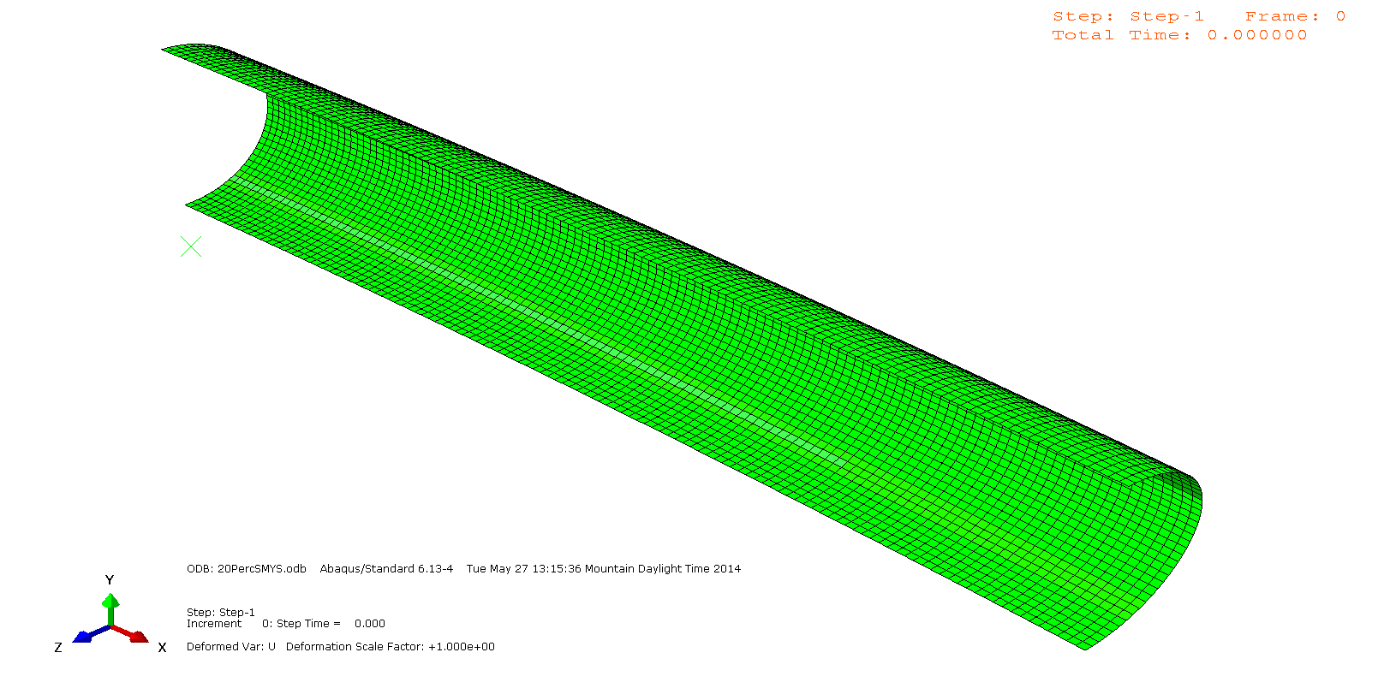
Internal Pressure and Bending in Cold Bends
Compression vs. Tension Failure
20%SMYS
Cakiroglu, C.; Kainat, M.; Adeeb S.; Cheng, J.J.R. and Sen, M. (2014). Evaluation of Pressurized Cold Bend Pipe Body Tensile Fractures Under Bending Loads. Proceedings of the International Pipeline Conference (IPC 2014), September 29-October 3, Calgary, Alberta, Canada.

Slide 22

Internal Pressure and Bending in Cold Bends
Compression vs. Tension Failure
67%SMYS
Cakiroglu, C.; Kainat, M.; Adeeb S.; Cheng, J.J.R. and Sen, M. (2014). Evaluation of Pressurized Cold Bend Pipe Body Tensile Fractures Under Bending Loads. Proceedings of the International Pipeline Conference (IPC 2014), September 29-October 3, Calgary, Alberta, Canada.

Slide 23
Internal Pressure and Bending in Cold Bends
Compression vs. Tension Failure
20%SMYS
67%SMYS
Cakiroglu, C.; Kainat, M.; Adeeb S.; Cheng, J.J.R. and Sen, M. (2014). Evaluation of Pressurized Cold Bend Pipe Body Tensile Fractures Under Bending Loads. Proceedings of the International Pipeline Conference (IPC 2014), September 29-October 3, Calgary, Alberta, Canada.

Slide 24
Internal Pressure and Bending in Cold Bends
Compression vs. Tension Failure
20%SMYS
67%SMYS
Cakiroglu, C.; Kainat, M.; Adeeb S.; Cheng, J.J.R. and Sen, M. (2014). Evaluation of Pressurized Cold Bend Pipe Body Tensile Fractures Under Bending Loads. Proceedings of the International Pipeline Conference (IPC 2014), September 29-October 3, Calgary, Alberta, Canada.

Slide 25
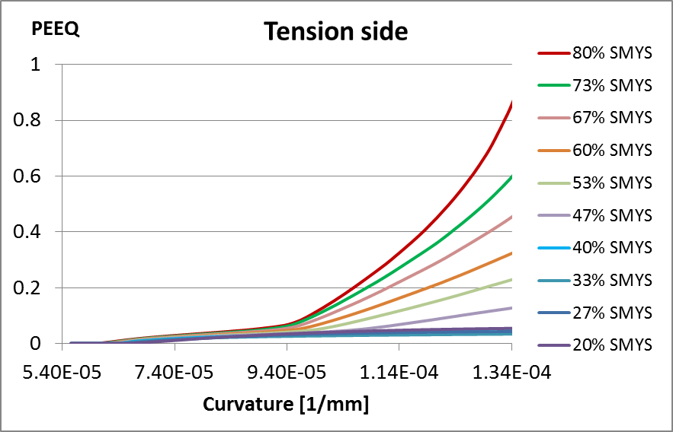
Internal Pressure and Bending in Cold Bends
Transition Pressure
Tension Side Fracture
Cakiroglu, C.; Kainat, M.; Adeeb S.; Cheng, J.J.R. and Sen, M. (2014). Evaluation of Pressurized Cold Bend Pipe Body Tensile Fractures Under Bending Loads. Proceedings of the International Pipeline Conference (IPC 2014), September 29-October 3, Calgary, Alberta, Canada.

Slide 26
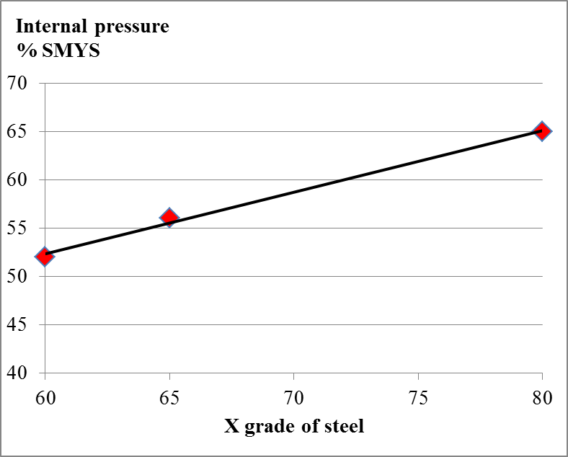
Internal Pressure and Bending in Cold Bends
Transition Pressure and Grade
Cakiroglu, C.; Kainat, M.; Adeeb S.; Cheng, J.J.R. and Sen, M. (2014). Evaluation of Pressurized Cold Bend Pipe Body Tensile Fractures Under Bending Loads. Proceedings of the International Pipeline Conference (IPC 2014), September 29-October 3, Calgary, Alberta, Canada.

Slide 27
Internal Pressure and Bending in Cold Bends
Future Work
Effect of Stress Strain Curve
Different OD and t
Straight pipes

Slide 28
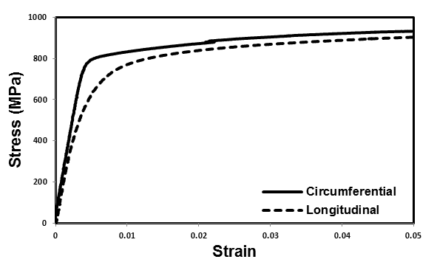
Material Properties of HSS Pipes
Anisotropy

Slide 29
Material Properties of HSS Pipes
Anisotropy

Slide 30
Material Properties of HSS Pipes
Which curve to use?
Internal Pressure (Circumferential?)
Lateral Loads (Longitudinal?)

Slide 31
Material properties of hss pipes
Bauschinger Effect
Stress
Strain

Slide 32
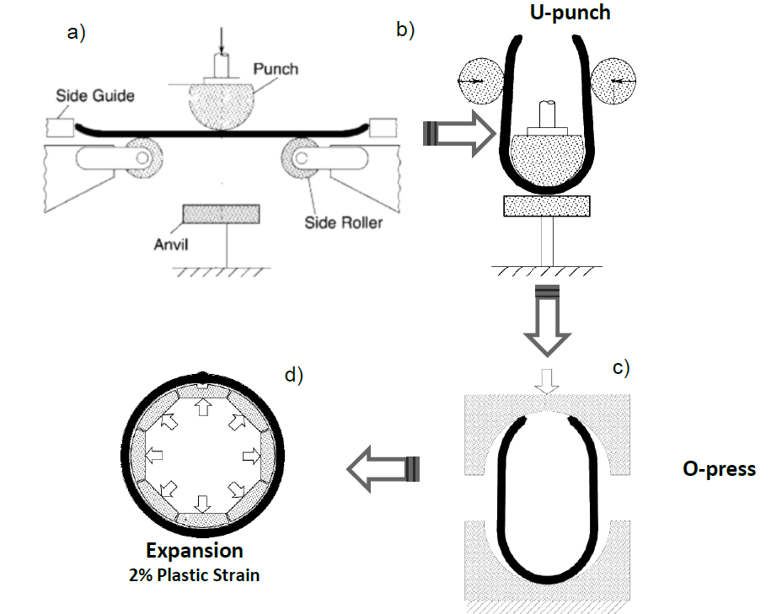
Material Properties of HSS Pipes
Manufacturing Process
Herynk, M.D.; Kyriakides, S.; Onoufriou, A. and Yun, H.D. (2007). Effects of the UOE/UOC pipe manufacturing processes on pipe collapse pressure. International Journal of Mechanical Sciences 49:533-553.

Slide 33
Material Properties of HSS Pipes
Pipe Expansion (Circumferential Stress Strain Curve)
Stress
Strain

Slide 34
Material Properties of HSS Pipes
Pipe Expansion (Circumferential Stress Strain Curve)
Stress
Stress
Strain

Slide 35
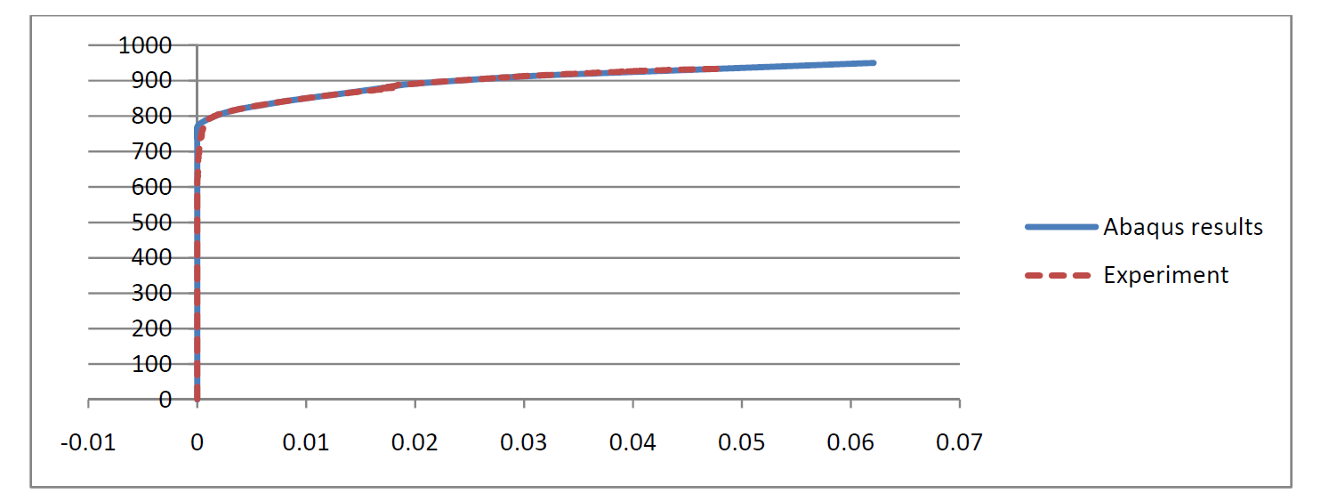
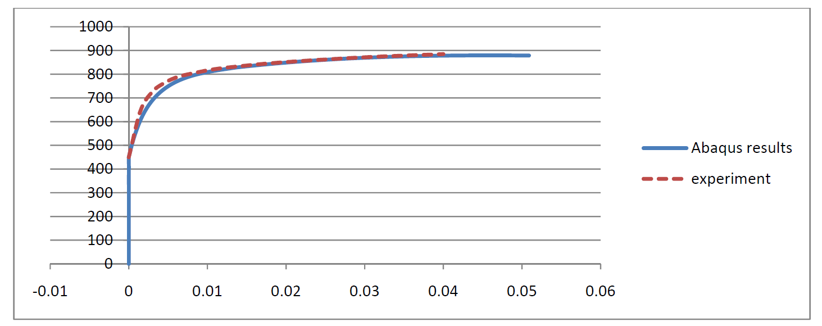
Material Properties of HSS Pipes
Bauschinger Effect Model
Stress
Plastic Strain
Stress
Plastic Strain
Neupane, S.; Adeeb, S.; Cheng, J.J.R., Ferguson, J. and Martens, M. (2012). Modelling the deformation response of high strength steel pipelines, Part I: Material characterization to model the plastic anisotropy. ASME Journal of Applied Mechanics, 79(5):051002 (9 pages).

Slide 36
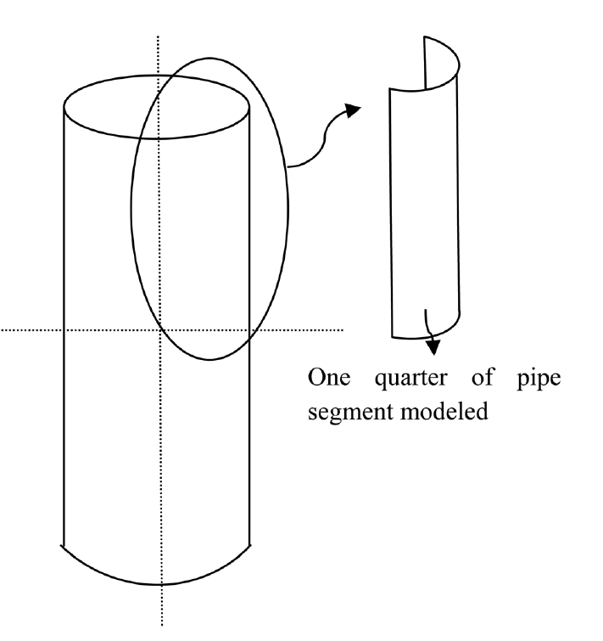
Material properties of hss pipes
Anisotropy and Buckling
Which curve should we use?
 | 0%SMYS | 80%SMYS
Circumferential | ☑ | ☑
Longitudinal | ☑ | ☑
Anisotropic model | ☑ | ☑

Slide 37
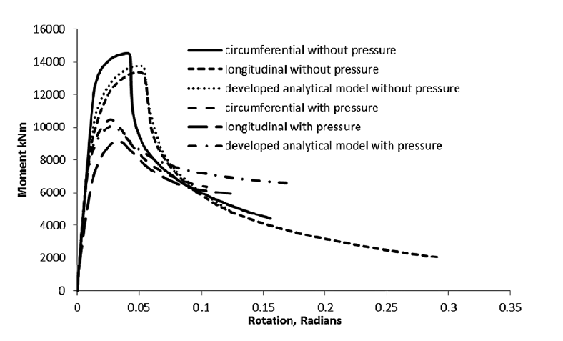
Material properties of hss pipes
Anisotropy and Buckling
Neupane, S.; Adeeb, S.; Cheng, J.J.R., Ferguson, J. and Martens, M. (2012). Modelling the deformation response of high strength steel pipelines, Part II: Effects of material characterization on the deformation response of pipes. ASME Journal of Applied Mechanics, 79(5):051003 (7 pages).

Slide 38
Material properties of hss pipes
Anisotropy and Buckling
Neupane, S.; Adeeb, S.; Cheng, J.J.R., Ferguson, J. and Martens, M. (2012). Modelling the deformation response of high strength steel pipelines, Part II: Effects of material characterization on the deformation response of pipes. ASME Journal of Applied Mechanics, 79(5):051003 (7 pages).

Slide 39
Material properties of hss pipes
Anisotropy and Buckling
At high values of internal pressure, the circumferential stress strain curve governs buckling behaviour
At zero internal pressure, the longitudinal stress strain curve governs buckling behaviour
Neupane, S.; Adeeb, S.; Cheng, J.J.R., Ferguson, J. and Martens, M. (2012). Modelling the deformation response of high strength steel pipelines, Part II: Effects of material characterization on the deformation response of pipes. ASME Journal of Applied Mechanics, 79(5):051003 (7 pages).

Slide 40
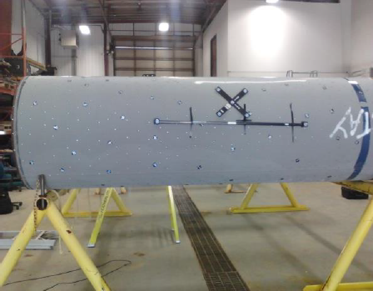
Initial Imperfections of HSS Pipes
Initial Imperfections Measurement
(20micrometer + 25micrometer/meter)

Slide 41
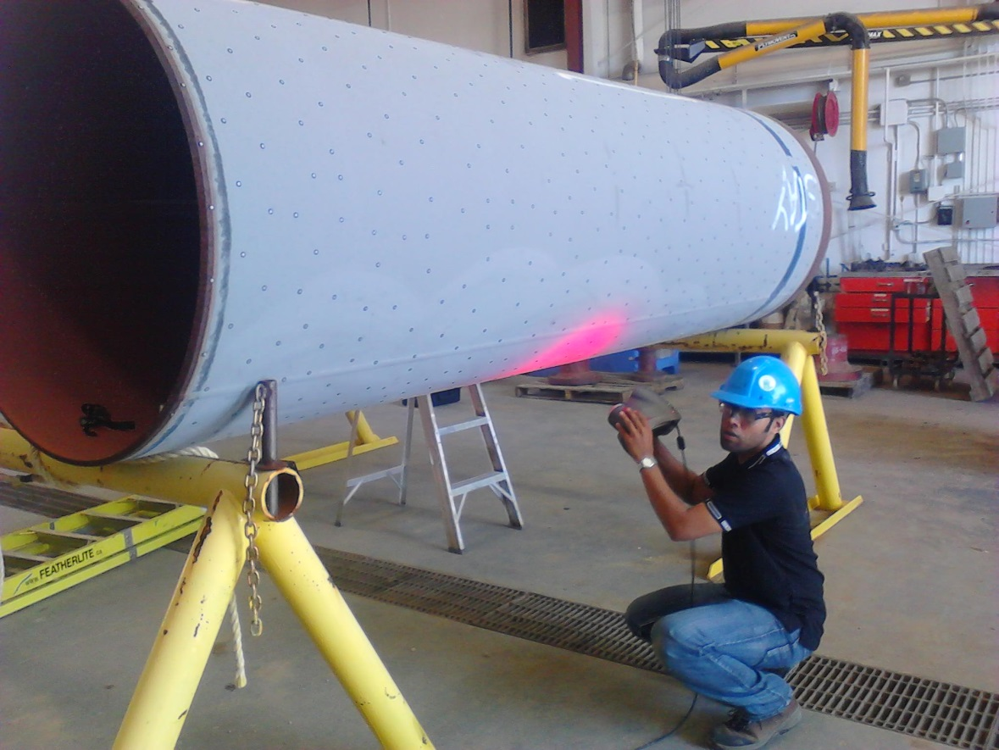
Initial Imperfections of HSS Pipes
Initial Imperfections Measurement
(20micrometer + 25micrometer/meter)

Slide 42
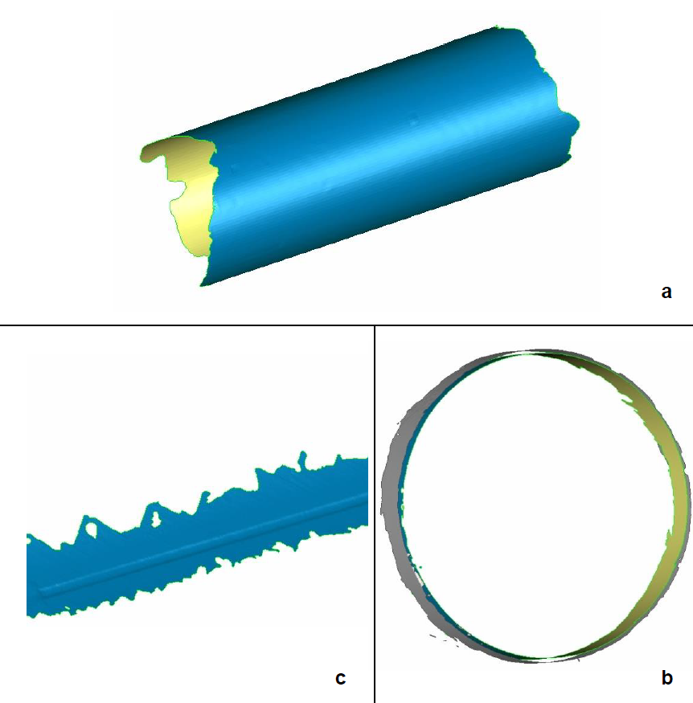
Initial imperfections of hss pipes
Best Fit Cylinder
Kainat, M.; Adeeb, S.; Cheng, J.J.R.; Ferguson, J. and Martens, M.(2012). Identifying initial imperfection patterns of energy pipes using a 3D laser scanner. Proceedings of the International Pipeline Conference (IPC), September 24-28, Calgary, Alberta, Canada. IPC2012-90201.

Slide 43
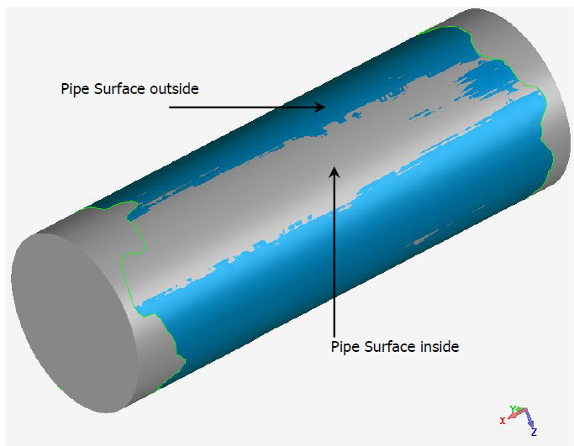
Initial imperfections of hss pipes
Initial Imperfection Measurements
Kainat, M.; Adeeb, S.; Cheng, J.J.R.; Ferguson, J. and Martens, M.(2012). Identifying initial imperfection patterns of energy pipes using a 3D laser scanner. Proceedings of the International Pipeline Conference (IPC), September 24-28, Calgary, Alberta, Canada. IPC2012-90201.

Slide 44
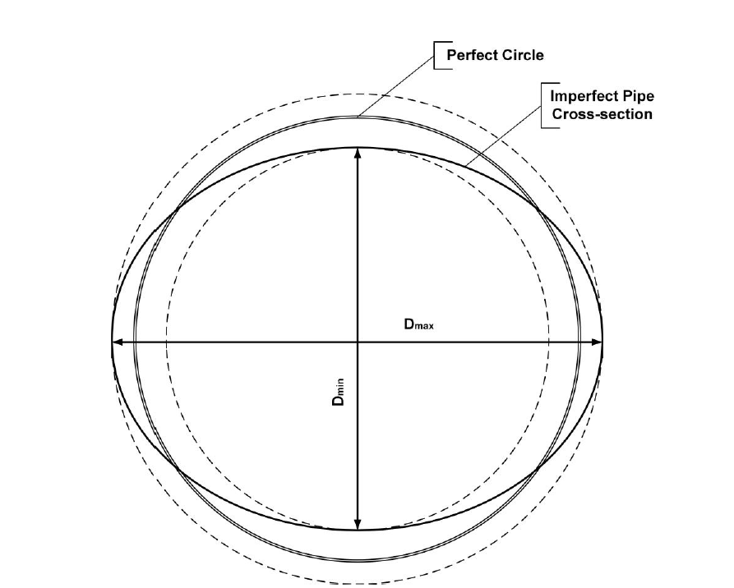
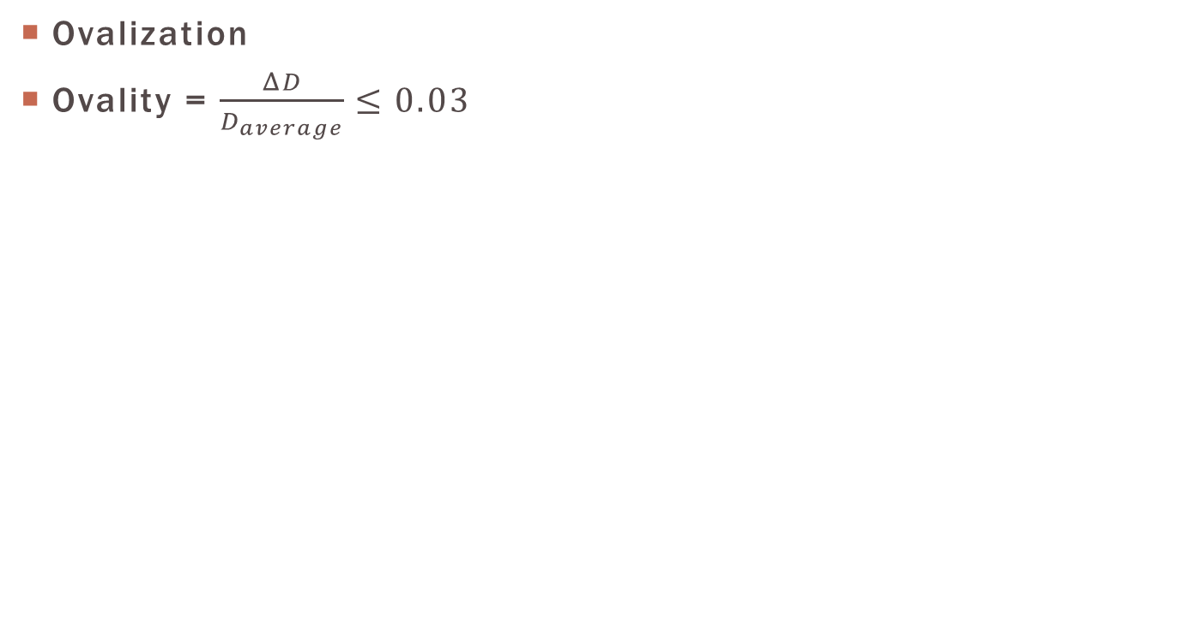
Initial imperfections of hss pipes
Ovalization
Ovality = $\frac{ΔD}{D_{average}}≤0.03$
Kainat, M.; Adeeb, S.; Cheng, J.J.R.; Ferguson, J. and Martens, M.(2012). Identifying initial imperfection patterns of energy pipes using a 3D laser scanner. Proceedings of the International Pipeline Conference (IPC), September 24-28, Calgary, Alberta, Canada. IPC2012-90201.

Slide 45
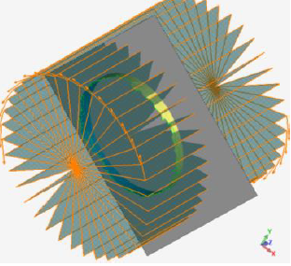
Initial imperfections of hss pipes
Wall Thickness Measurement
Kainat, M.; Adeeb, S.; Cheng, J.J.R.; Ferguson, J. and Martens, M.(2012). Identifying initial imperfection patterns of energy pipes using a 3D laser scanner. Proceedings of the International Pipeline Conference (IPC), September 24-28, Calgary, Alberta, Canada. IPC2012-90201.

Slide 46
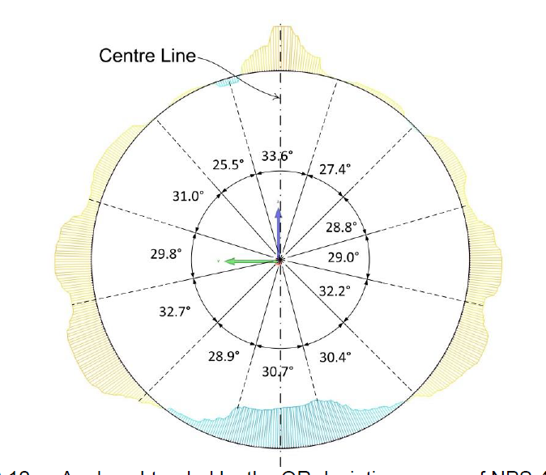
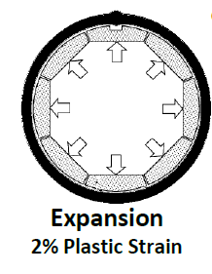
Initial imperfections of hss pipes
Ovality Results
Kainat, M.; Adeeb, S.; Cheng, J.J.R.; Ferguson, J. and Martens, M.(2012). Identifying initial imperfection patterns of energy pipes using a 3D laser scanner. Proceedings of the International Pipeline Conference (IPC), September 24-28, Calgary, Alberta, Canada. IPC2012-90201.

Slide 47
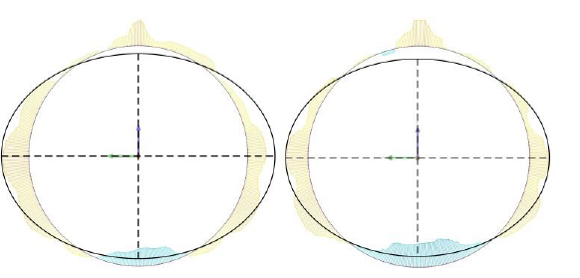
Initial imperfections of hss pipes
Ovality Results
Kainat, M.; Adeeb, S.; Cheng, J.J.R.; Ferguson, J. and Martens, M.(2012). Identifying initial imperfection patterns of energy pipes using a 3D laser scanner. Proceedings of the International Pipeline Conference (IPC), September 24-28, Calgary, Alberta, Canada. IPC2012-90201.

Slide 48
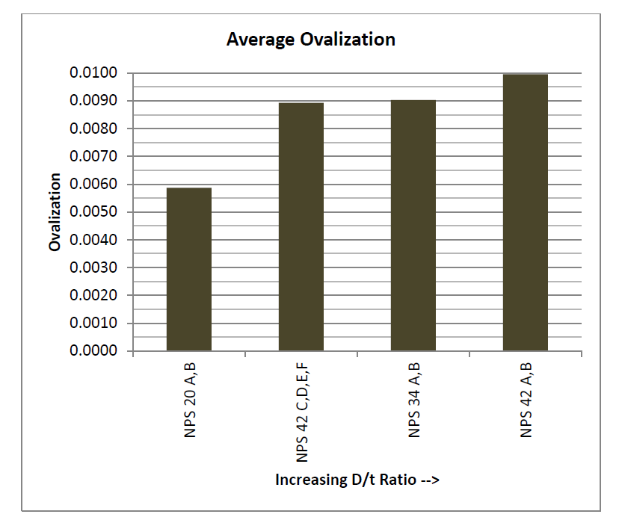
Initial imperfections of hss pipes
Ovality Results
Kainat, M.; Adeeb, S.; Cheng, J.J.R.; Ferguson, J. and Martens, M.(2012). Identifying initial imperfection patterns of energy pipes using a 3D laser scanner. Proceedings of the International Pipeline Conference (IPC), September 24-28, Calgary, Alberta, Canada. IPC2012-90201.

Slide 49
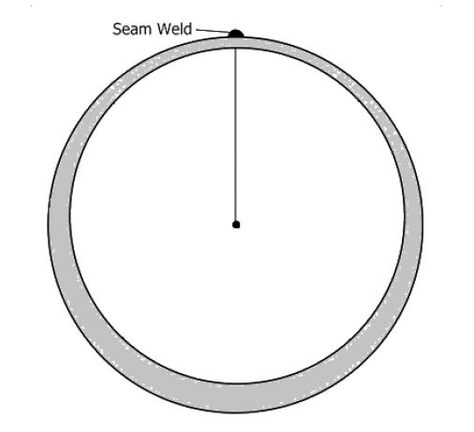
Initial imperfections of hss pipes
Wall Thickness Results
Upto 15% decrease
Upto 30% increase
Kainat, M.; Adeeb, S.; Cheng, J.J.R.; Ferguson, J. and Martens, M.(2012). Identifying initial imperfection patterns of energy pipes using a 3D laser scanner. Proceedings of the International Pipeline Conference (IPC), September 24-28, Calgary, Alberta, Canada. IPC2012-90201.

Slide 50
Initial imperfections of hss pipes
Ovality vs. Wall Thickness Imperfections and Buckling

Slide 51
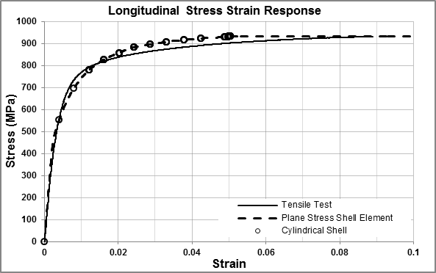
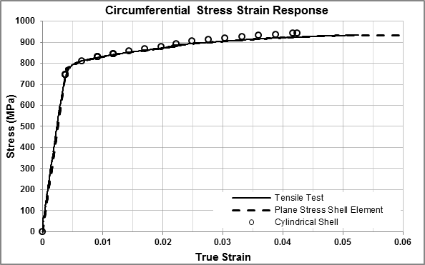
Initial imperfections of hss pipes
Ovality vs. Wall Thickness Imperfections and Buckling
NPS 42, 14.275mm wall thickness. X100

Slide 52
Initial imperfections of hss pipes
Ovality vs. Wall Thickness Imperfections and Buckling
and OR2 Imperfection Model
OR1 Imperfection Model
OR2 Imperfection Model

Slide 53
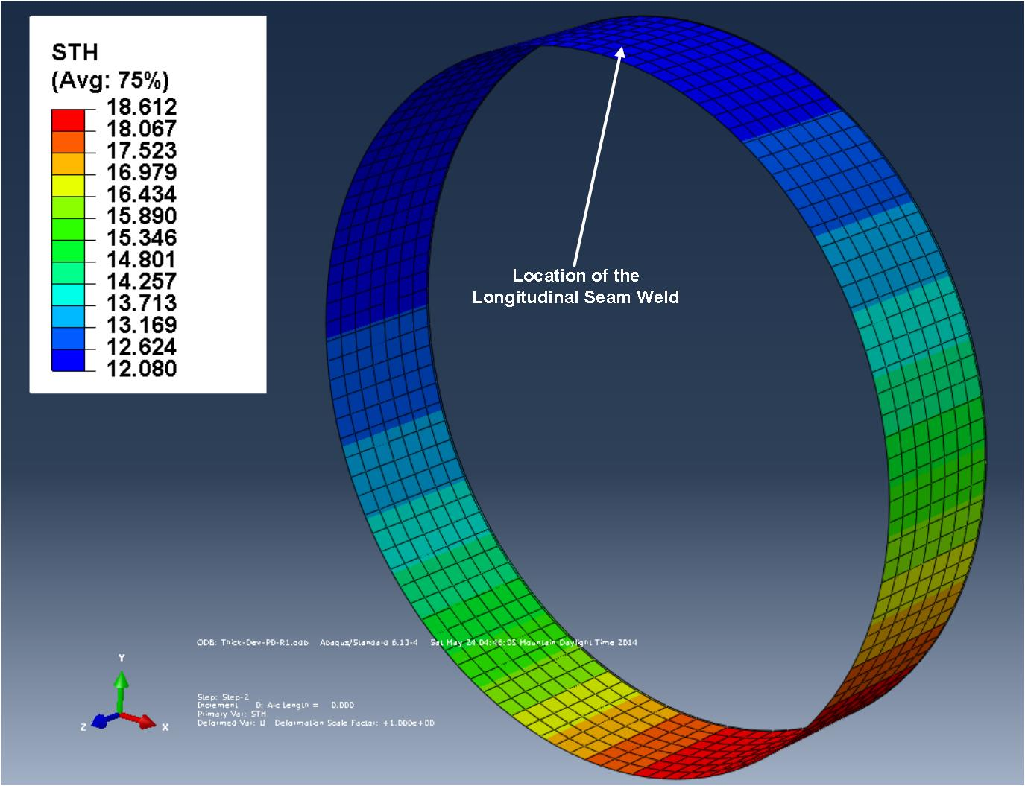
Initial imperfections of hss pipes
Ovality vs. Wall Thickness Imperfections and Buckling
Wall Thickness Imperfection

Slide 54
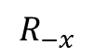




Initial imperfections of hss pipes
Ovality vs. Wall Thickness Imperfections and Buckling
Compare Ideal Pipe with:
 | 0%SMYS |  |  |  | 80%SMYS
 | $$R_{x}$$ | $$R_{−x}$$ | $$R_{y}$$ | $$R_{−y}$$ | $$R_{x}$$ | $$R_{−x}$$ | $$R_{y}$$ | $$R_{−y}$$
OR1 | ☑ | ☑ | ☑ | ☑ | ☑ | ☑ | ☑ | ☑
OR2 | ☑ | ☑ | ☑ | ☑ | ☑ | ☑ | ☑ | ☑
WT | ☑ | ☑ | ☑ | ☑ | ☑ | ☑ | ☑ | ☑
Seam Weld
Seam Weld
Seam Weld
Seam Weld
y
y
$$R_{x}$$
$$R_{−x}$$
$$R_{y}$$
$$R_{−y}$$
x
x

Slide 55


Initial imperfections of hss pipes
Oval vs. Ideal Pipe: No Difference!

Slide 56
Initial imperfections of hss pipes
Wall thickness imperfection vs. Ideal Pipe:
Seam Weld
Seam Weld
Seam Weld
Seam Weld
y
y
$$R_{x}$$
$$R_{−x}$$
$$R_{y}$$
$$R_{−y}$$
x
x

Slide 57


Initial imperfections of hss pipes
Wall thickness imperfection vs. Ideal Pipe:

Slide 58
Initial imperfections of hss pipes
Wall thickness imperfection vs. Ideal Pipe:
Wall Thickness Deviation Model
 | Direction | Peak Moment | Difference | End Rotation | Difference
 | Of Rotation | (kN-m) |  | (Radians)
Without Pressure | R_{x} | 11401 | 4.72% | 0.1271 | 32.41%
 | R_{-x} | 10254 | -5.81% | 0.0697 | -27.32%
 | R_{y} | 11211 | 2.97% | 0.1141 | 18.89%
 | R_{-y} | 10411 | -4.37% | 0.0768 | -20.01%
With Pressure | R_{x} | 9647 | 22.88% | 0.1488 | 29.76%
 | R_{-x} | 6305 | -19.69% | 0.1021 | -11.00%
 | R_{y} | 8950 | 14.00% | 0.1345 | 17.30%
 | R_{-y} | 6880 | -12.37% | 0.1064 | -7.24%

Slide 59
summary
In severe bending situations, internal pressure can cause rupture on the tension side!
HSS pipes have anisotropic behaviour which should be included for precise modelling
HSS pipeline imperfections are dependent on the UOE manufacturing process
Wall Thickness Imperfections can reduce the moment capacity by up to 20%
Wall Thickness Imperfections can reduce the critical strain by up to 27%

Slide 60
Acknowledgements
Co-investigator:
Dr. Roger Cheng.
Chair, Civil and Environmental Engineering
Students:
Sunil Neupane
Muntaseer Kainat
Celal Cakiroglu
Meng Lin
Enbridge:
Dr. Millan Sen
TCPL:
Michael Martens
James Ferguson
Funding:
NSERC

Slide 61
Questions
?

